Slide 1
Spotify Music Recommendation System
Zeeshan Hussain Khand :1880109
Noman Nazir Malik : 1874453

Slide 2
Agenda
Introduction
Project Goal and Objective
Recommendation System Techniques
Spotify Web API & Spotipy Library for python
PySpark Session and spark dataframe
Data Pre-processing ,Manipulation and EDA
Clustering with K-means to find pattern in recommendation
Technique 1 : Popularity Recommendation
Technique 2 : Collaborative Recommendation
Technique 3 : Content – Based Recommendation
Learning and Conclusion
Summary

Slide 3
Introduction : Project Objective
The goal of this Project is to develop a recommendation system using Spotify data of a user. We use the Spotify data to generate recommendation in the form of playlist for a user to listen.
For generating recommended playlist, we use the following recommendation system techniques:
Popularity Recommendation
Content Based Recommendation
Collaborative Recommendation.

Slide 4
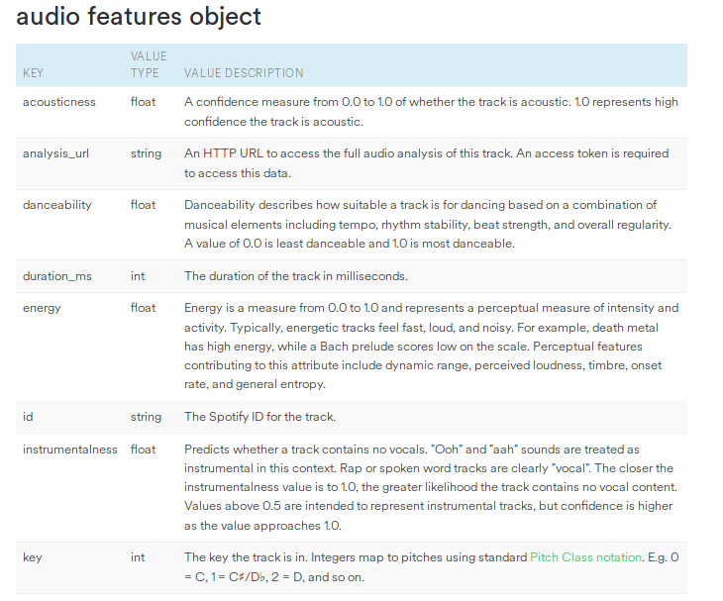
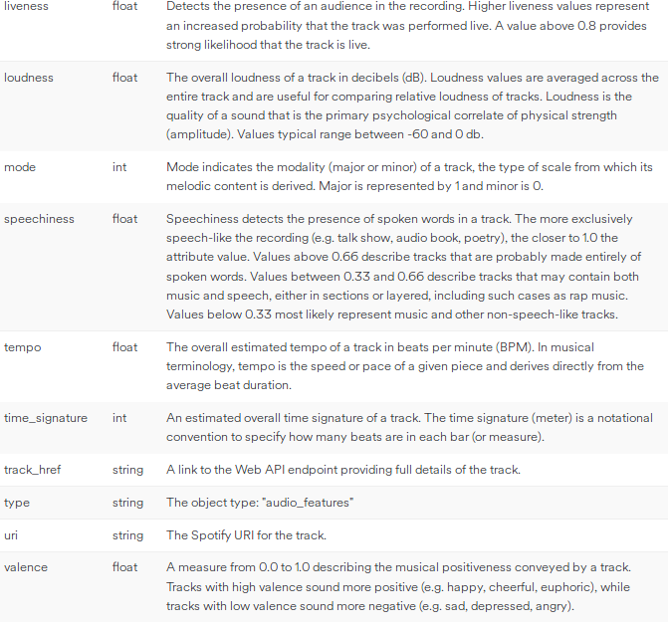
Prominent Features in Data
For the information on all track features extracted : Please refer to https://developer.spotify.com/documentation/web-api/reference/#/operations/get-track

Slide 5
Recommendation System Techniques
Popularity Recommendation System
Content-based Recommender
Collaborative Recommender
Recommend popular songs regardless of user's preferences
Use song attributes (e.g., genre) to recommend similar songs
Predict what songs a user might be interested in based on a collection of preference information from multiple users(i.e playlists)

Slide 6
Spotify Web API for Python : Spotipy
Spotipy is a lightweight Python library for the Spotify Web API. With Spotipy you get full access to all the music data provided by the Spotify platform.

Slide 7
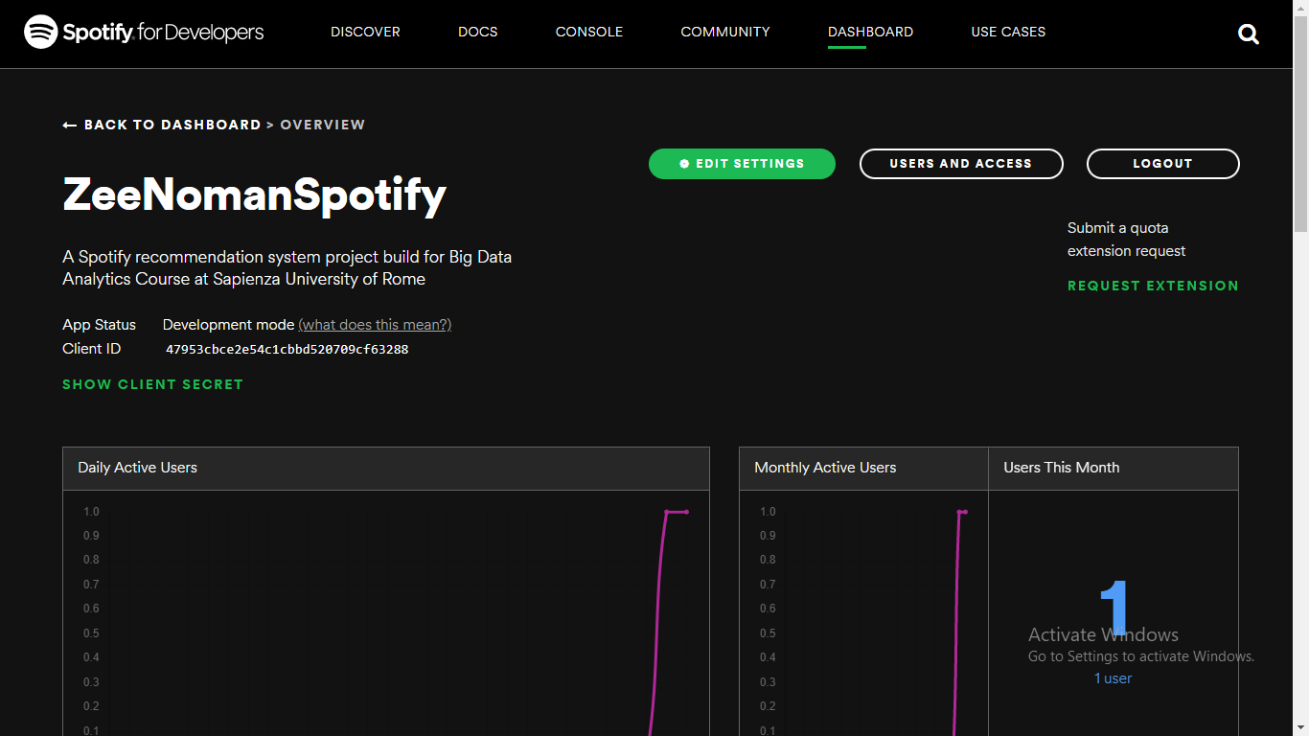
Spotify Web Dashboard

Slide 8
Flow of Project
1. Download and Setup Pyspark for the project
2. We connect Spotify account and generate a dataframe of all songs in user playlist
3. Create Spark Dataframe and Pre-process the data
4. Data Manipulation and Exploratory Data Analysis
5. Cluster Songs with K-means
6. Implement Popularity Recommender for Recommendation
7. Apply Collaborative Filtering for recommendation
8. Apply Content Based Recommendation

Slide 9
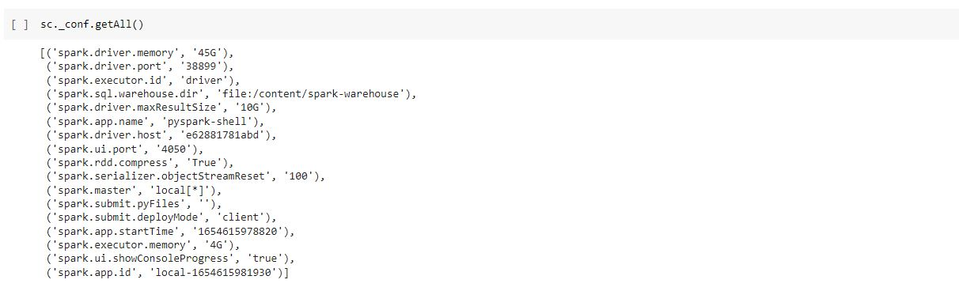
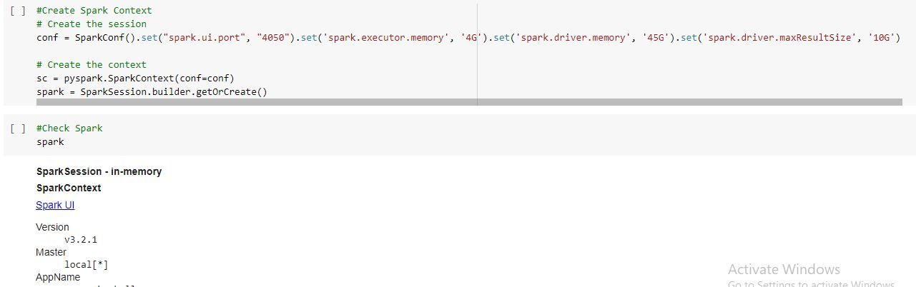
Create Pyspark Session
1. Create Spark Session
2. Check Spark Configurations

Slide 10
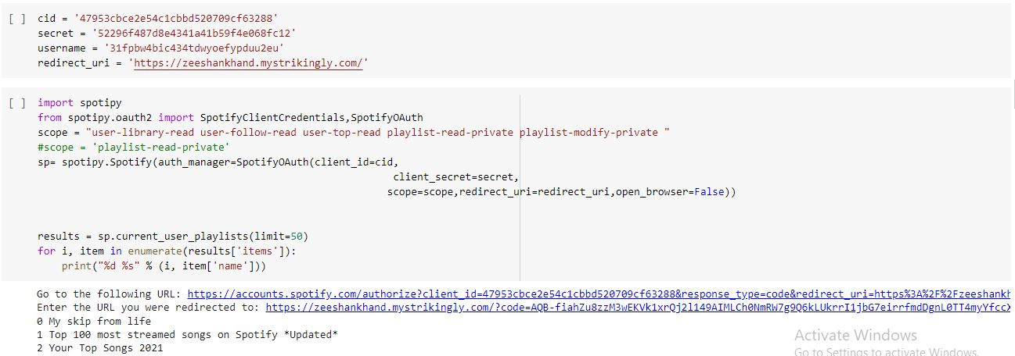
Connect Spotify Account and Authentication

Slide 11
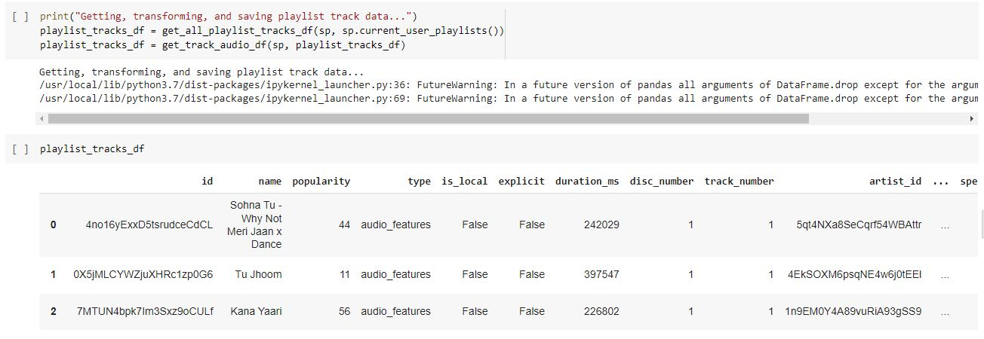
Get all songs of User

Slide 12
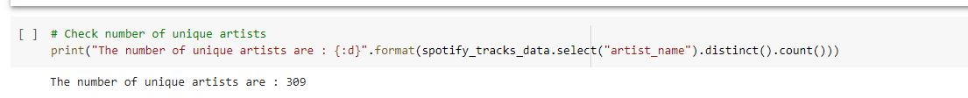
Data Manipulation and EDA
Query : Number of Unique artists

Slide 13
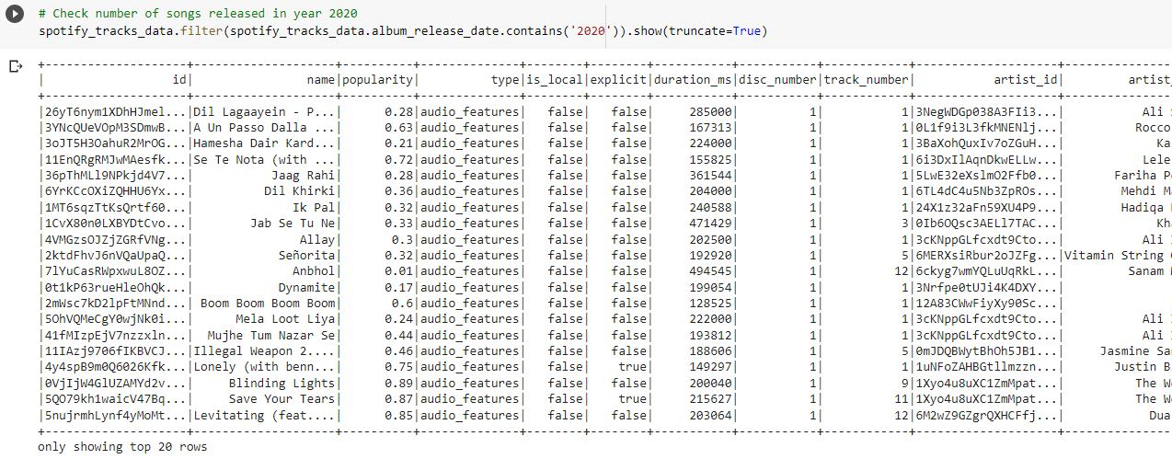
Data Manipulation and EDA
Query : Songs released in 2020

Slide 14
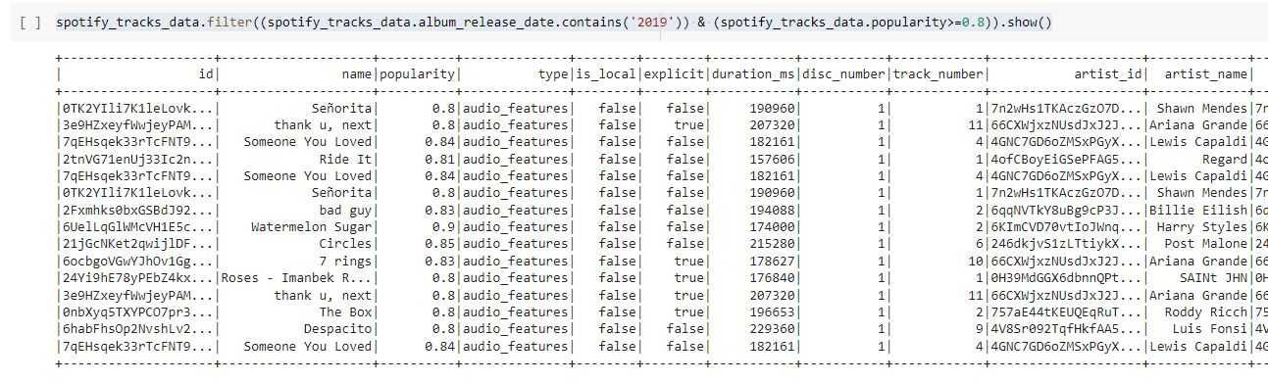
Data Manipulation and EDA
Query : Songs released in 2019 and very popular

Slide 15
Summary of all features

Slide 16
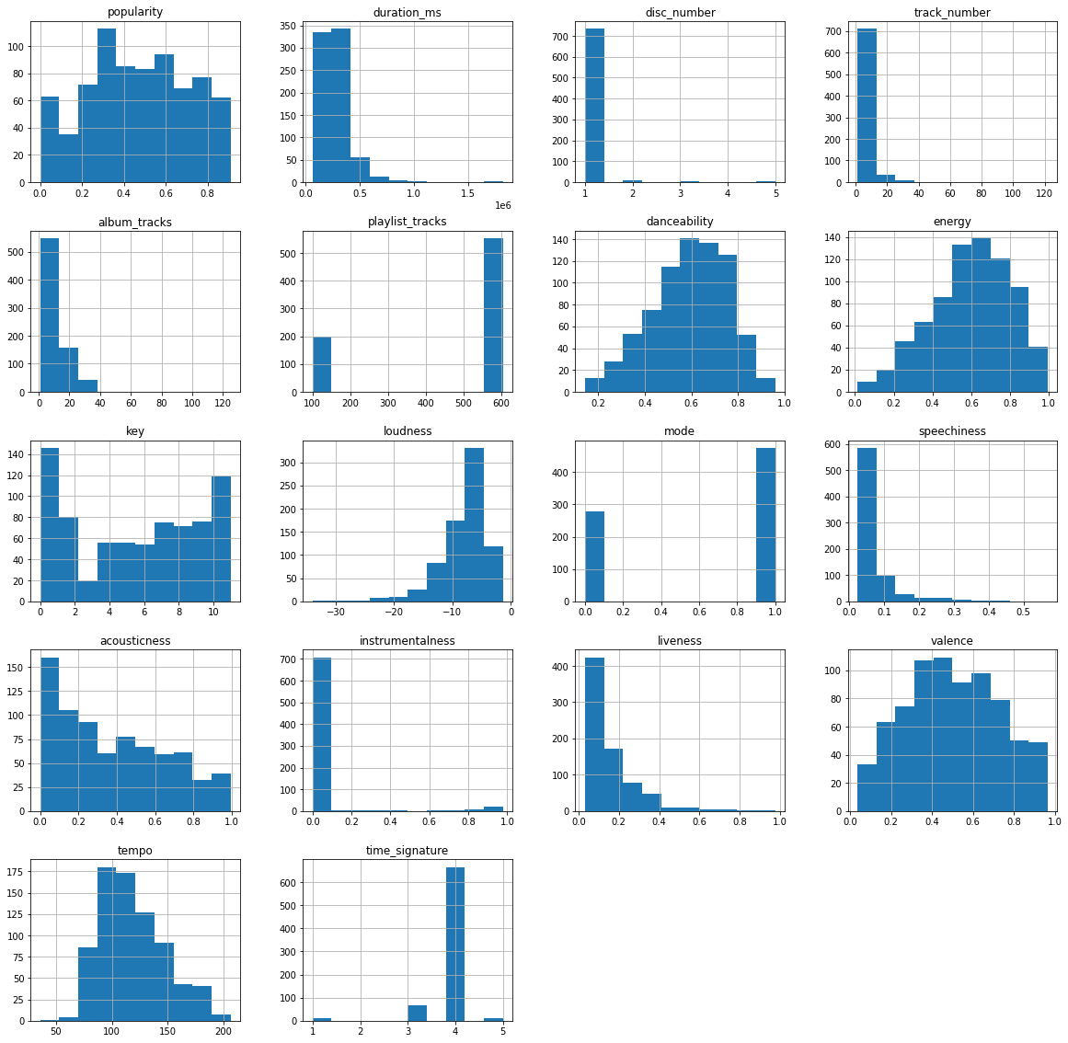

Slide 17
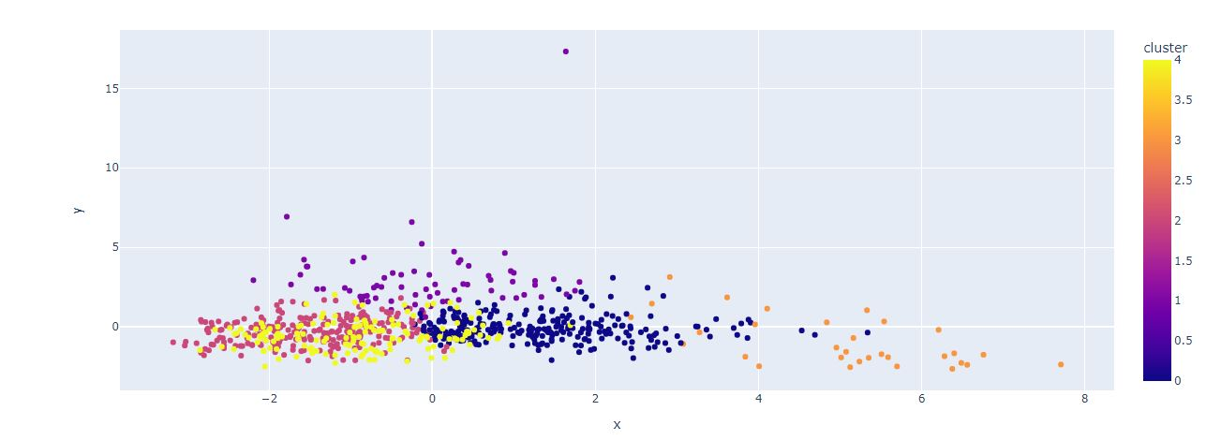
Clustering with K-means and PCA

Slide 18
Technique 1 : Popularity Recommender

Slide 19
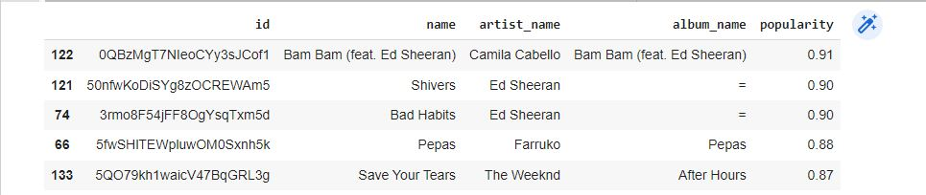
What is Popularity Recommender ?
A popularity recommender recommends songs ranked by their popularity regardless of user’s preferences. This is of course dependent upon the methodology used to determine the popularity metric (usually some function of time, user interactions, and user ratings).

Slide 20
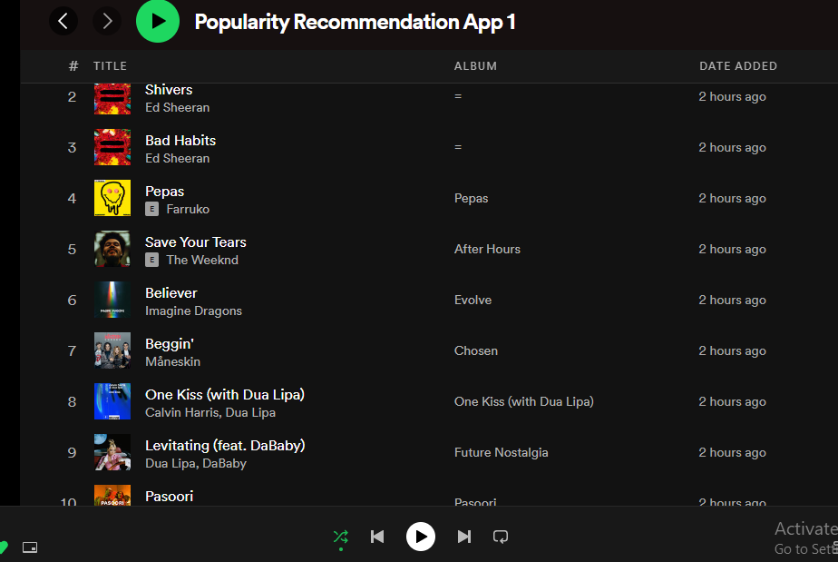
The generated playlist
The playlist generated is available here.

Slide 21
Some Conclusions
A popularity-based recommender recommends songs in order of overall popularity, regardless of what the user has listened to. Spotify's 'audio features' API call automatically comes with a 'popularity' feature. Although it is 0 in ~10% of cases (higher than expectrf - these are probably default null values), this is perfect for creating a Popularity recommender.
As song popularity generally accounts for the "wisdom of the crowds", it usually provides good recommendations overall.
However, this isn't tailored to the user in particular, as a good recommender system should be.

Slide 22
Technique 2: Collaborative Recommendation System

Slide 23
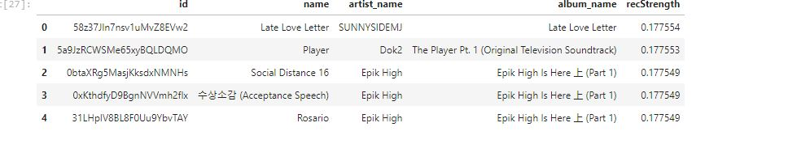
What is Collaborative Recommendation ?
A collaborative recommender can be either memory-based (based on past user interactions) or model-based (e.g., clustering).
Here an items×users' matrix is then used to recommend items to users based on the interactions of similar users.

Slide 24
Matrix Factorization
Latent factor models compress a user-item matrix into a low-dimensional representation in terms of latent factors. This has several advantages including fewer missing values, better scalability during similarity comparison, and that we will be dealing with a much smaller matrix in lower-dimensional space. Note that model-based approaches handle the sparsity of the original matrix better than memory-based ones. An important number is the number of selected factors to factor the user-item matrix. The higher the number of factors, the more precise is the factorisation, and the more details of the original matrix which are memorized. Reducing the number of factors increases the model generalisation whilst too many factors can lead to overfitting (high variance).
Here we a use popular latent factor model named Singular Value Decomposition (SVD) which is available in SciPy. Other choices might have been surprise, mrec, or python-recsys.

Slide 25
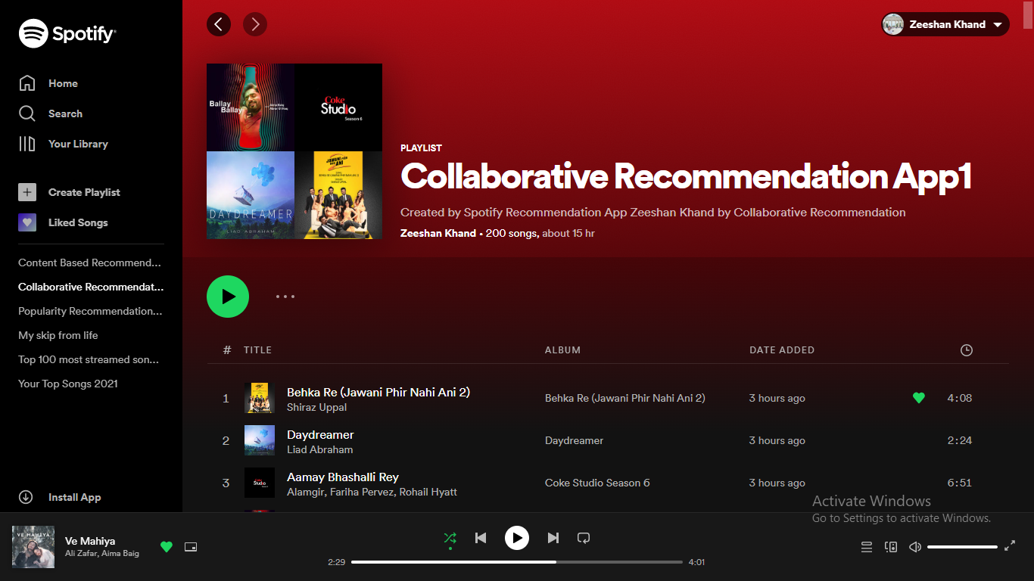
The generated playlist
The playlist generated is available here.

Slide 26
Technique 3: Content Based Recommendation

Slide 27
What is Content Based Recommendation?
Content-based filtering uses the features of each item to find the similarities items. By assigning a score to how similar each item is, we can recommend an item based on how similar it is to all other items in the dataset.
In the context of Spotify playlists, we use the features (loudness, tempo, etc.) of each song in a playlist to find the average score of the whole playlist. Then, we recommend a song that has a score similar to the playlist but is not in the playlist.
So in short = Content-based Filtering: Recommend songs that are similar to the other songs in the dataset.

Slide 28
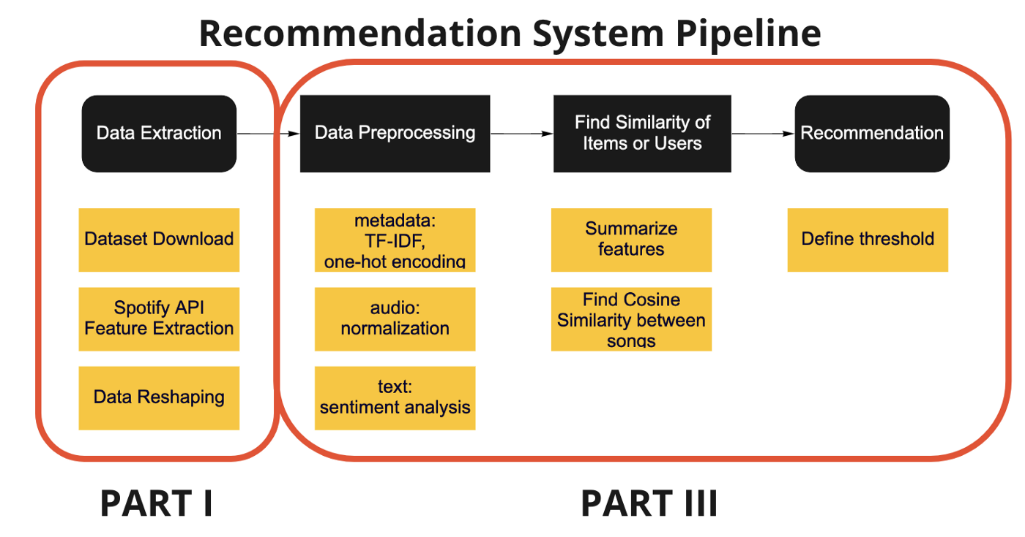
The pipeline of Recommendation

Slide 29
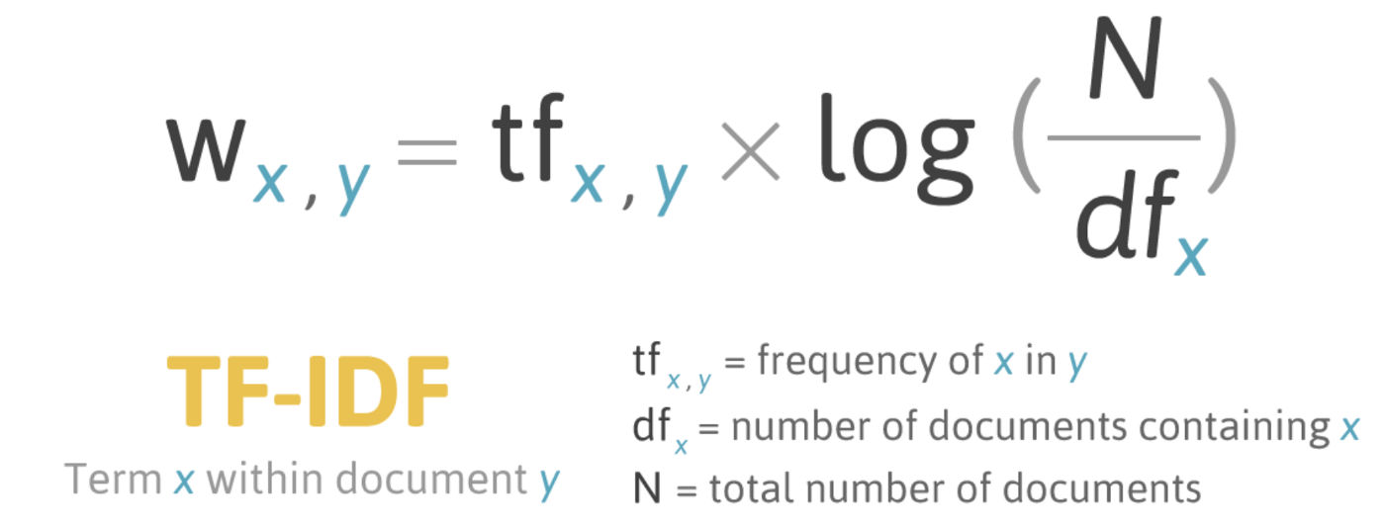
TF-IDF measures
TF-IDF, also known as Term Frequency-Inverse Document Frequency, is a tool to quantify words in a set of documents. The goal of TF-IDF is to show the importance of a word in the documents and the corpus. The general formula for calculating TF-IDF is:
Term Frequency (TF): The number of times a term appears in each document divided by the total word count in the document.
Inverse Document Frequency (IDF): The log value of the document frequency. Document frequency is the total number of documents where one term is present.
Notes:
The motivation is to find words that are not only important in each document but also account for the entire corpus. The log value was taken to decrease the impact of a large N, which would lead to a very large IDF compared to TF. TF is focused on the importance of a word in a document, while IDF is focused on the importance of a word across documents.
In this project, the documents are analogous to songs. Therefore, we are calculating the most prominent genre in each song and their prevalence across songs to determine the weight of the genre. This is much better than simply one-hot encoding since there are no weights to determine how important and widespread each genre is, leading to overweighting on uncommon genres.

Slide 30
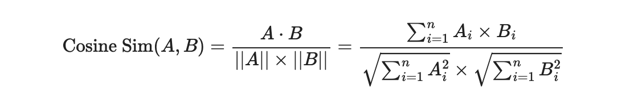
Similarity Recommendation
After retrieving the playlist summarized vector and the non-playlist songs, we can find the similarity between each individual song in the database and the playlist. The similarity metric chosen is cosine similarity.
Cosine similarity is a mathematical value that measures the similarities between vectors.

Slide 31
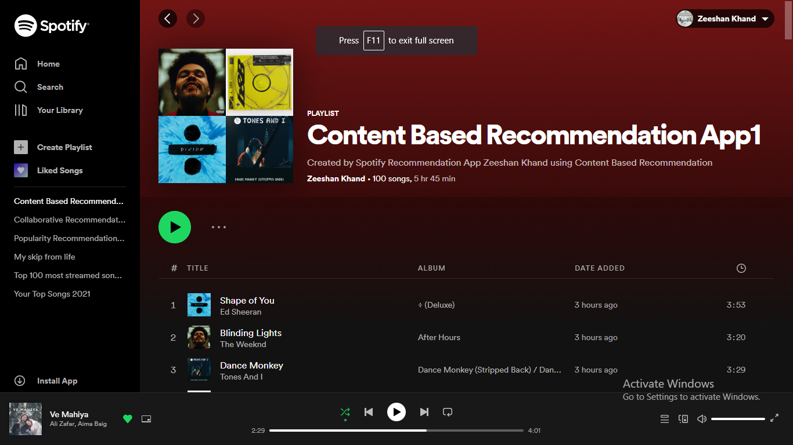
The generated playlist
The playlist generated is available here.

Slide 32
Learnings and Conclusion
Not a proper metric train the model, resulting in a lack of technique to measure success that can help improve the model.
The only way to check if the recommendations are good is to manually verify if the songs cater to your music taste.
To use the recommenders, users should have at least one playlist on their Spotify account, which is a disadvantage in the case of an entirely new user of the Spotify application.

Slide 33
Learnings and Conclusion
Not a proper metric train the model, resulting in a lack of technique to measure success that can help improve the model.
The only way to check if the recommendations are good is to manually verify if the songs cater to your music taste.
To use the recommenders, users should have at least one playlist on their Spotify account, which is a disadvantage in the case of an entirely new user of the Spotify application.
In principle, content-based recommendation generated a playlist for me that I would binge listen to and that covered all my music genres and tastes.
Popularity recommender gave me new songs to listen to but they were not tailored to my taste but rather categorized by popularity

Slide 34
Summary
We developed a recommendation system that generates playlist using user songs collection. Three playlist are generated using three popular techniques for recommendation.
Popularity recommendation method
Content-based recommendation method
Collaborative recommendation method

Slide 35
Thank you
Questions ?

